Slide 1
Lecture 11

Slide 2
Lecture 11 objectives
Understand and apply protein detection techniques
Apply principles to purify proteins

Slide 3
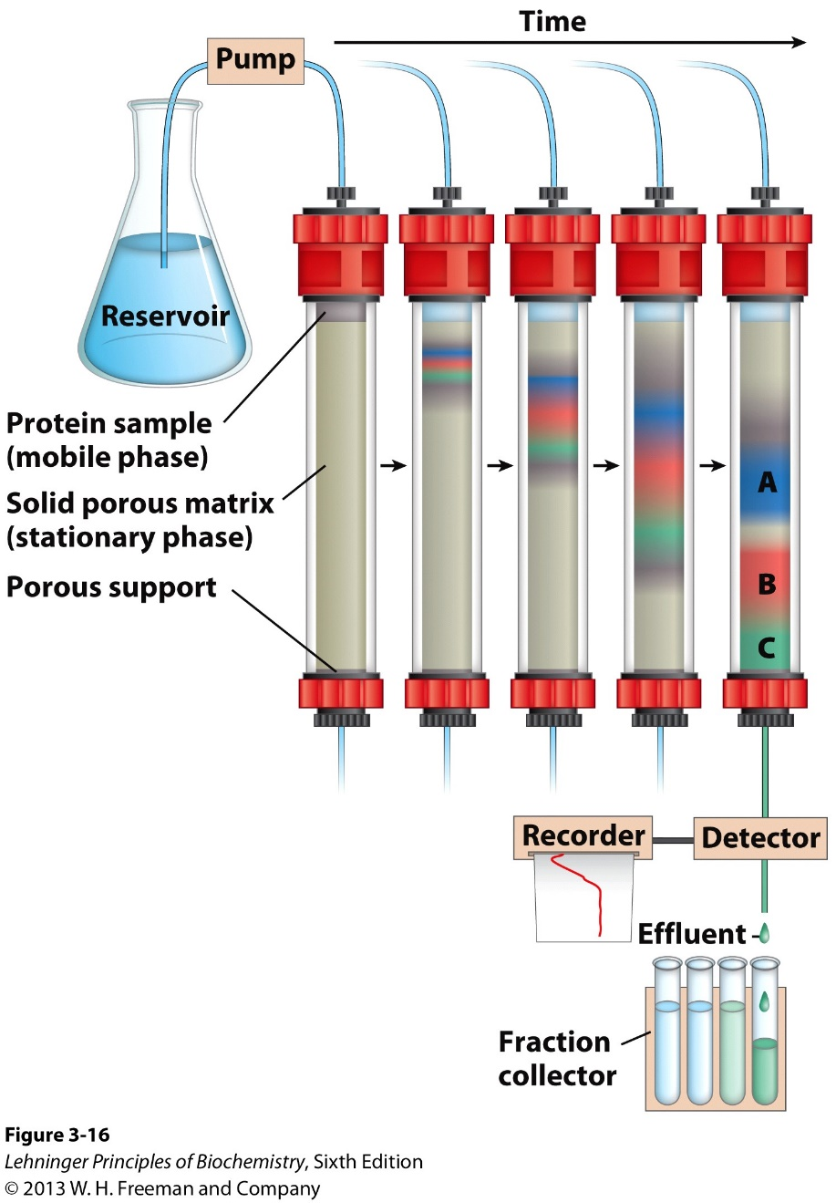
Column chromatography: General principle
Notes:
Stopped here!

Slide 4
Separating proteins
What physical properties of proteins can we use to create differences in mobility?
A. Charge, pH, solubility
B. Solubility, Charge, Size
C. Size, Affinity, Charge
D. Uum. Cut off their legs??

Slide 5
Gel filtration column: Size

Slide 6
Gel filtration column: Size
Fraction 1

Slide 7
Gel filtration column: Size
Fraction 1
Fraction 2

Slide 8
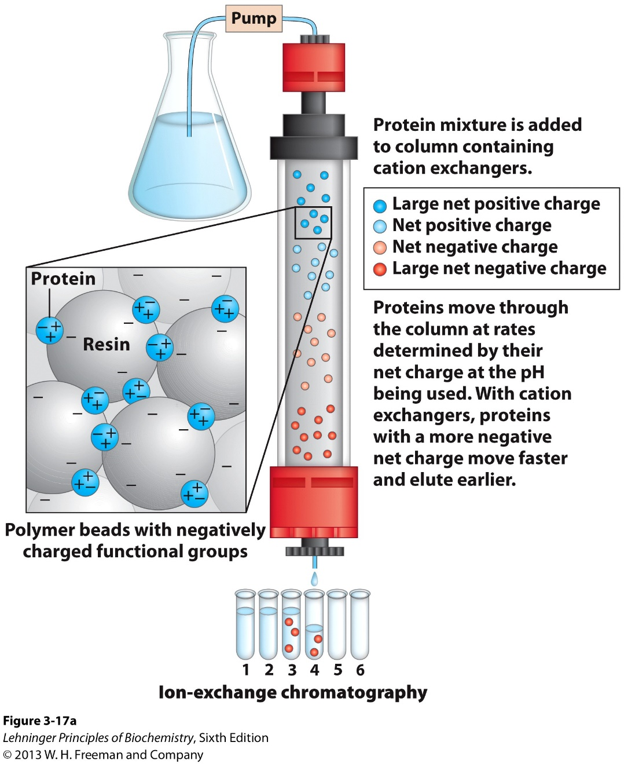
Ion exchange column: Charge
TERMINOLOGY NOTE:
Anion exchange
Cation exchange

Slide 9
Column chromatography
Activity
Activity
Fractions

Slide 10
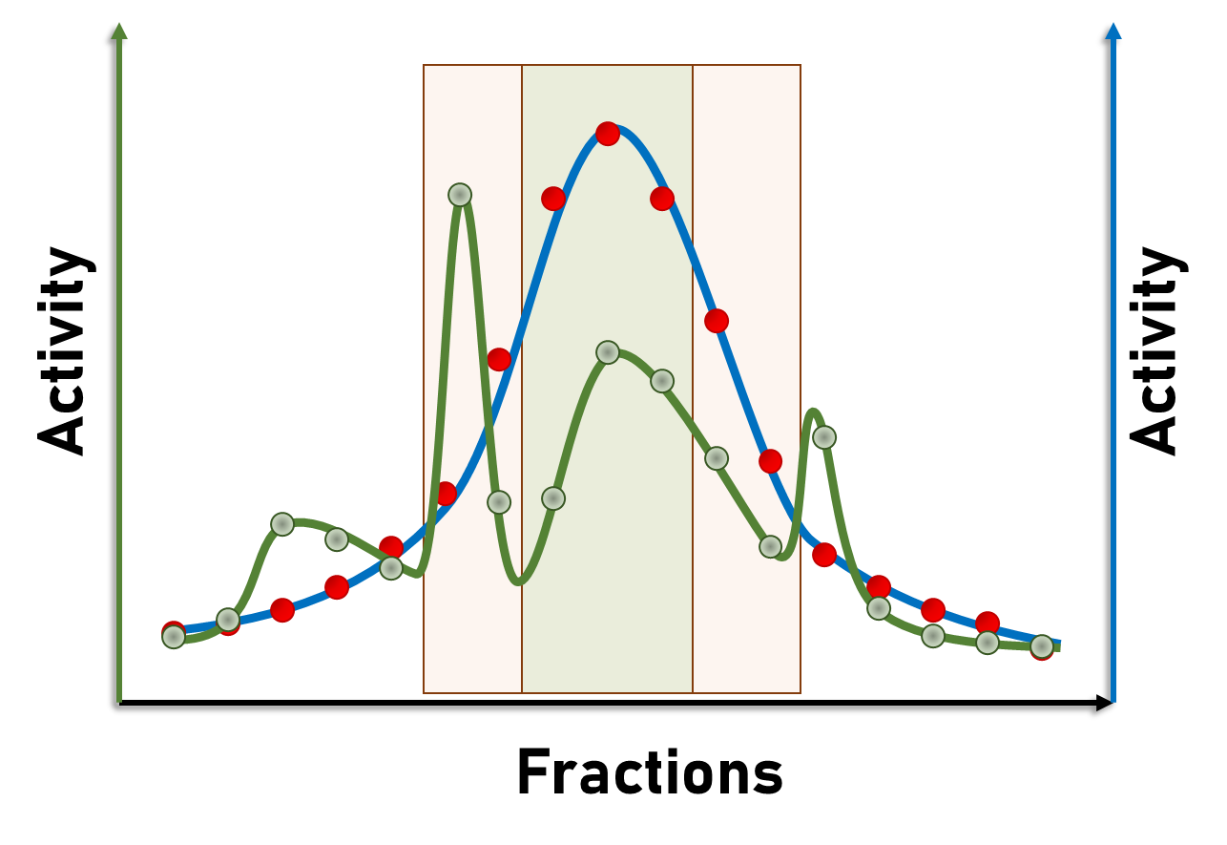
Column chromatography
What would increase in Brown vs Green?
A. Specific activity
B. Total activity
C. Purity
D. Uum. Length of the line??

Slide 11
Column chromatography
What would increase in Green vs Brown?
A. Specific activity
B. Total activity
C. Purity
D. Uum. Length of the line??

Slide 12
Column chromatography
Proteins that will elute in fractions
Column
Early
Middle
Late
Gel filtration
Large
Intermediate
Small
Cation xchanger
Anion xchanger
Affinity column

Slide 13
Separating proteins
Mixture of three proteins.
A = 22kD, neutral at pH 7, binds to Fructose
B = 78kD, neutral at pH 7, binds to Glucose
C = 21kD, +4 at pH 7, binds to Fructose
How to purify all three proteins?

Slide 14
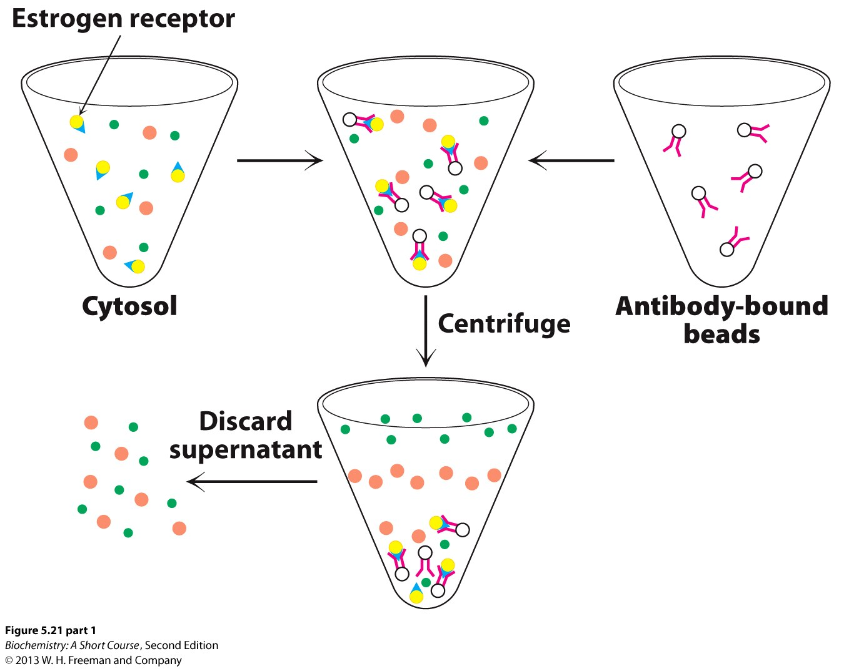
Immunoprecipitation

Slide 15
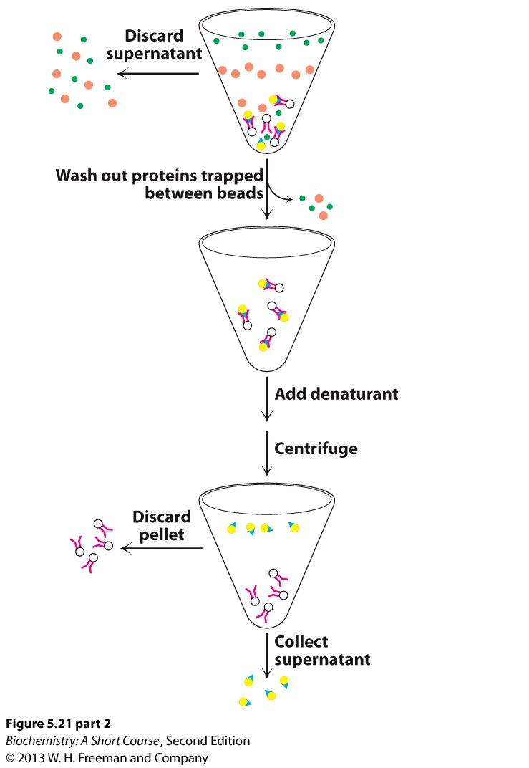
Immunoprecipitation

Slide 16
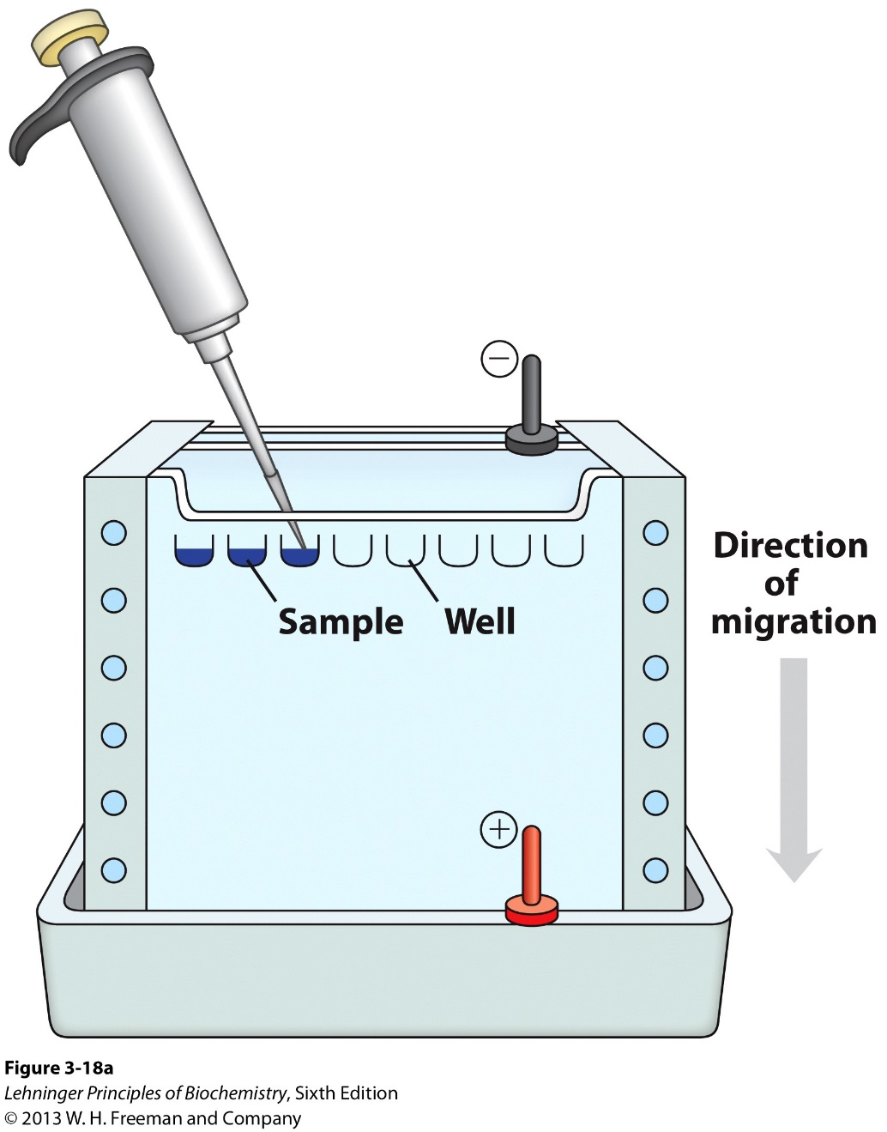
Separating & detecting proteins: PAGE

Slide 17
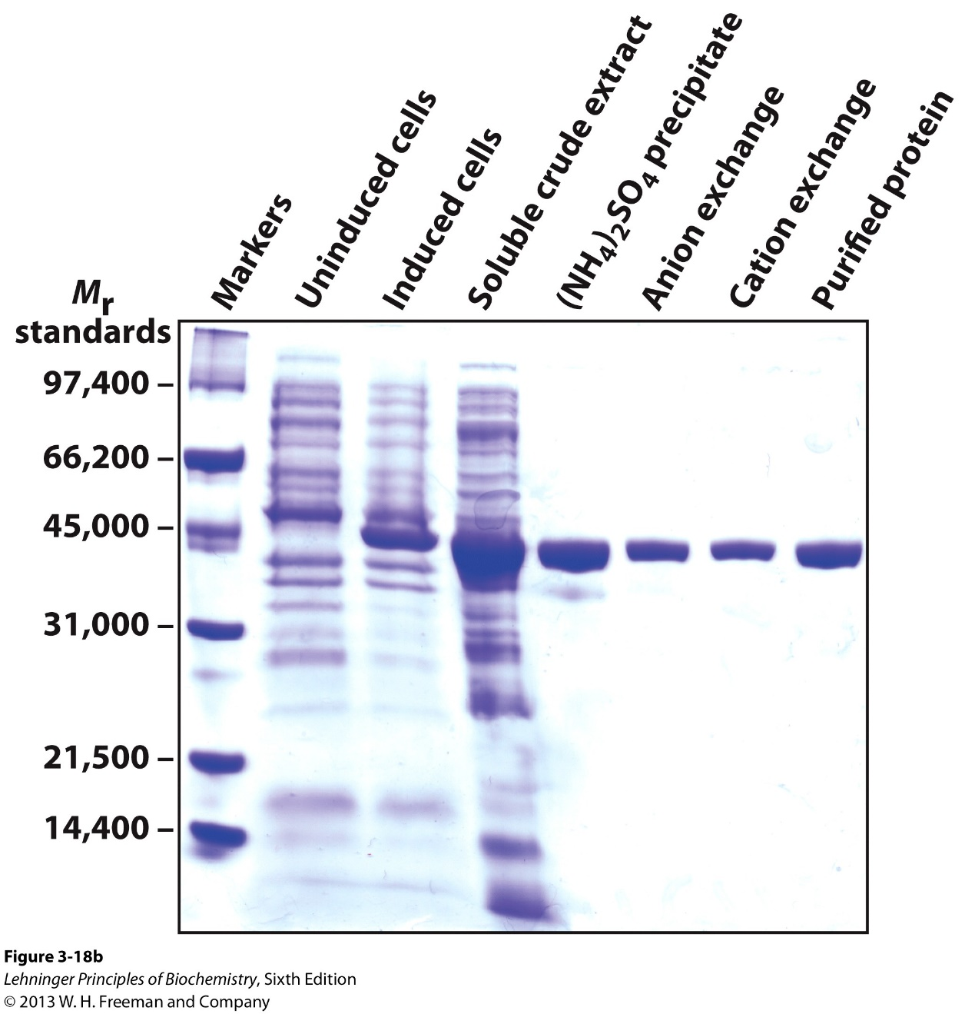
Separating & detecting proteins: PAGE

Slide 18
One issue with PAGEs….
20 KD protein
35 KD protein
PAGE
Run the same!!
???

Slide 19
SDS-PAGE
SDS:
Detergent:
-ve charge:
Protein + SDS → PAGE =
Protein + SDS → PAGE = Separate by ?
Protein + SDS → PAGE = Separate by

Slide 20
PAGE vs SDS-PAGE
PAGE (Native)
SDS-PAGE
Sample NOT treated with SDS/anything else
Proteins in native conformation
Separation based on mass AND shape

Slide 21
1 band = ? proteins
See ONE band on a PAGE. How many proteins?
A. Most likely 1, but could be more
B. 0
C. 1
D. 2
E. 3

Slide 22
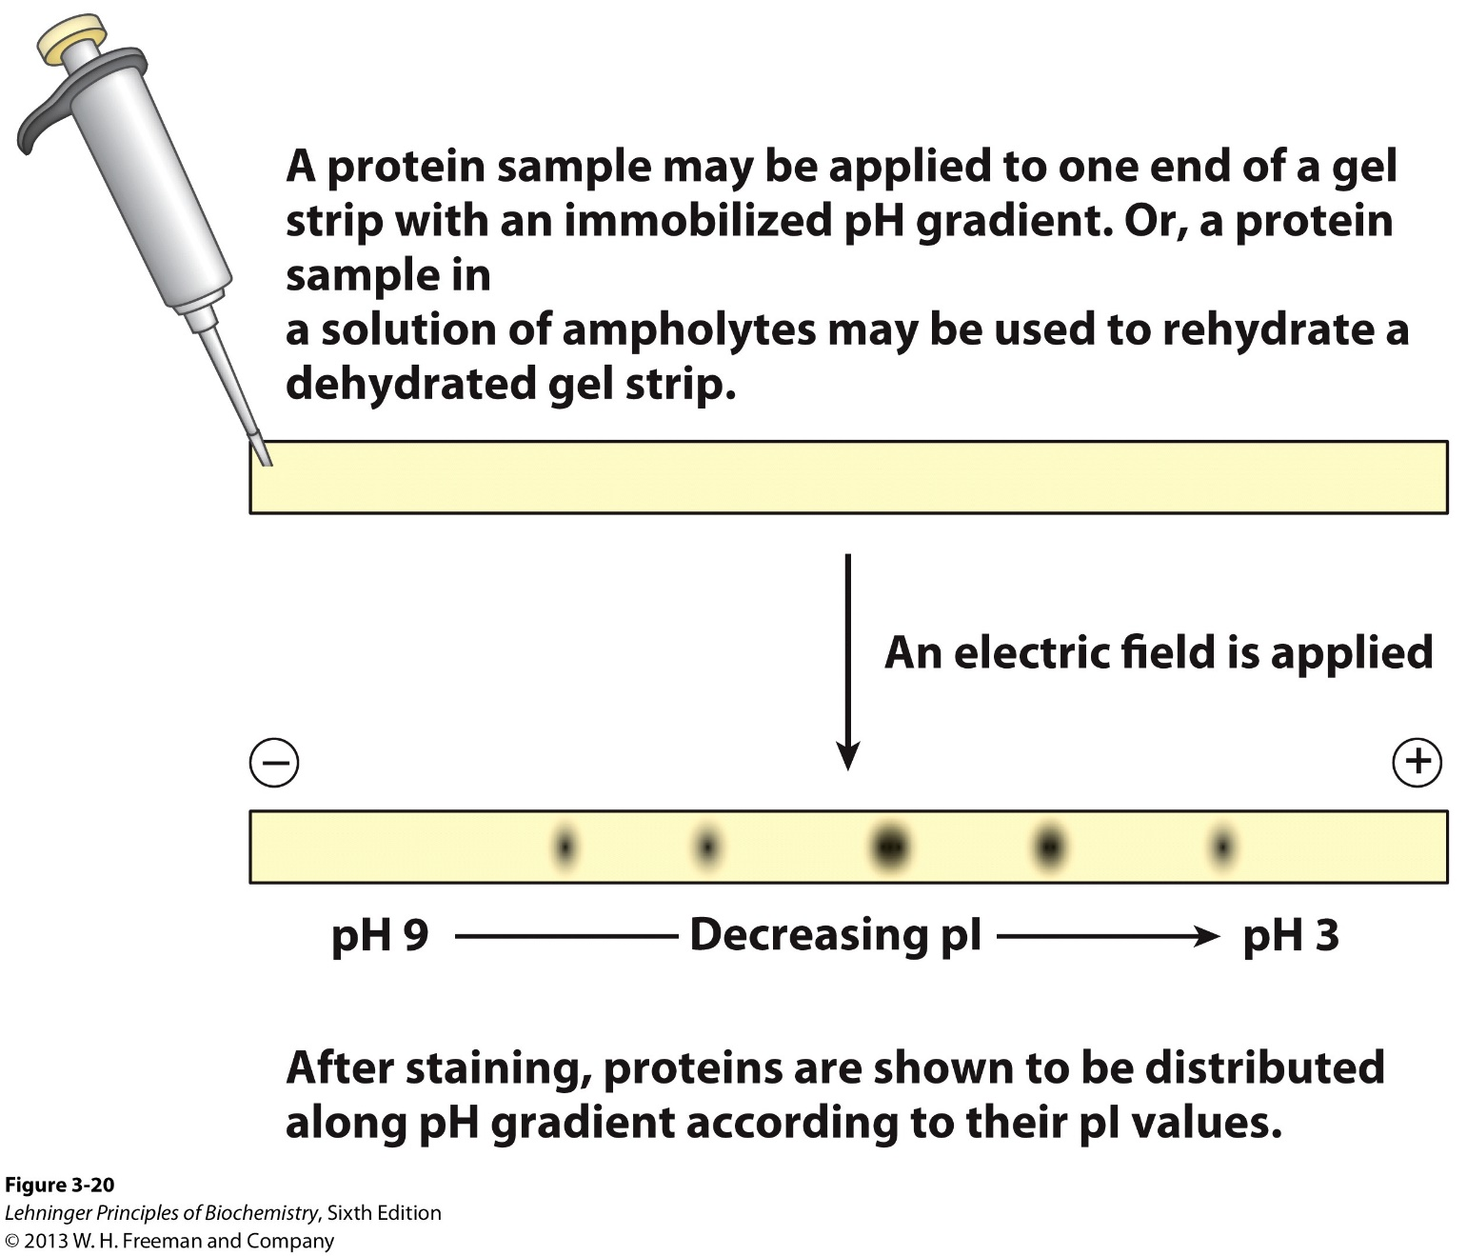
Separating & detecting: Isoelectric focusing

Slide 23
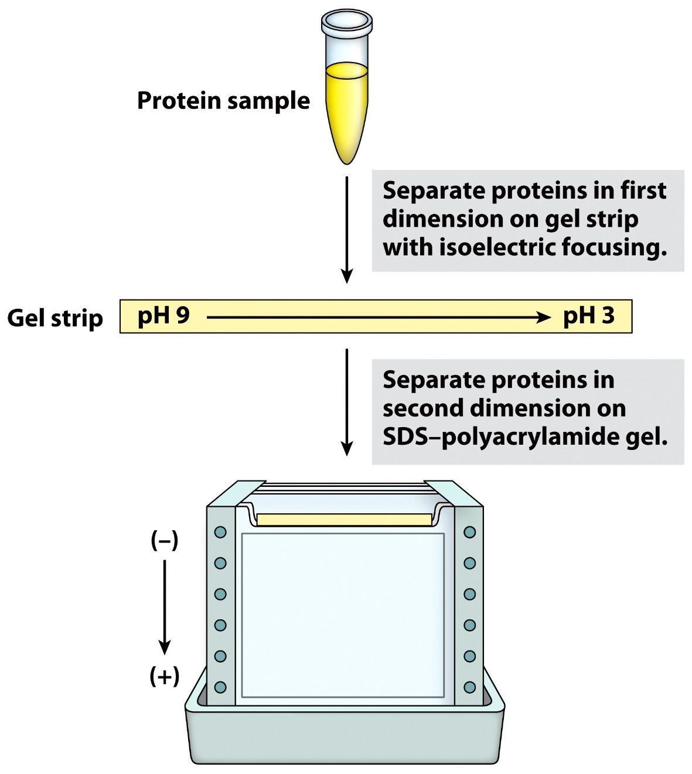
2D Gel Electrophoresis

Slide 24
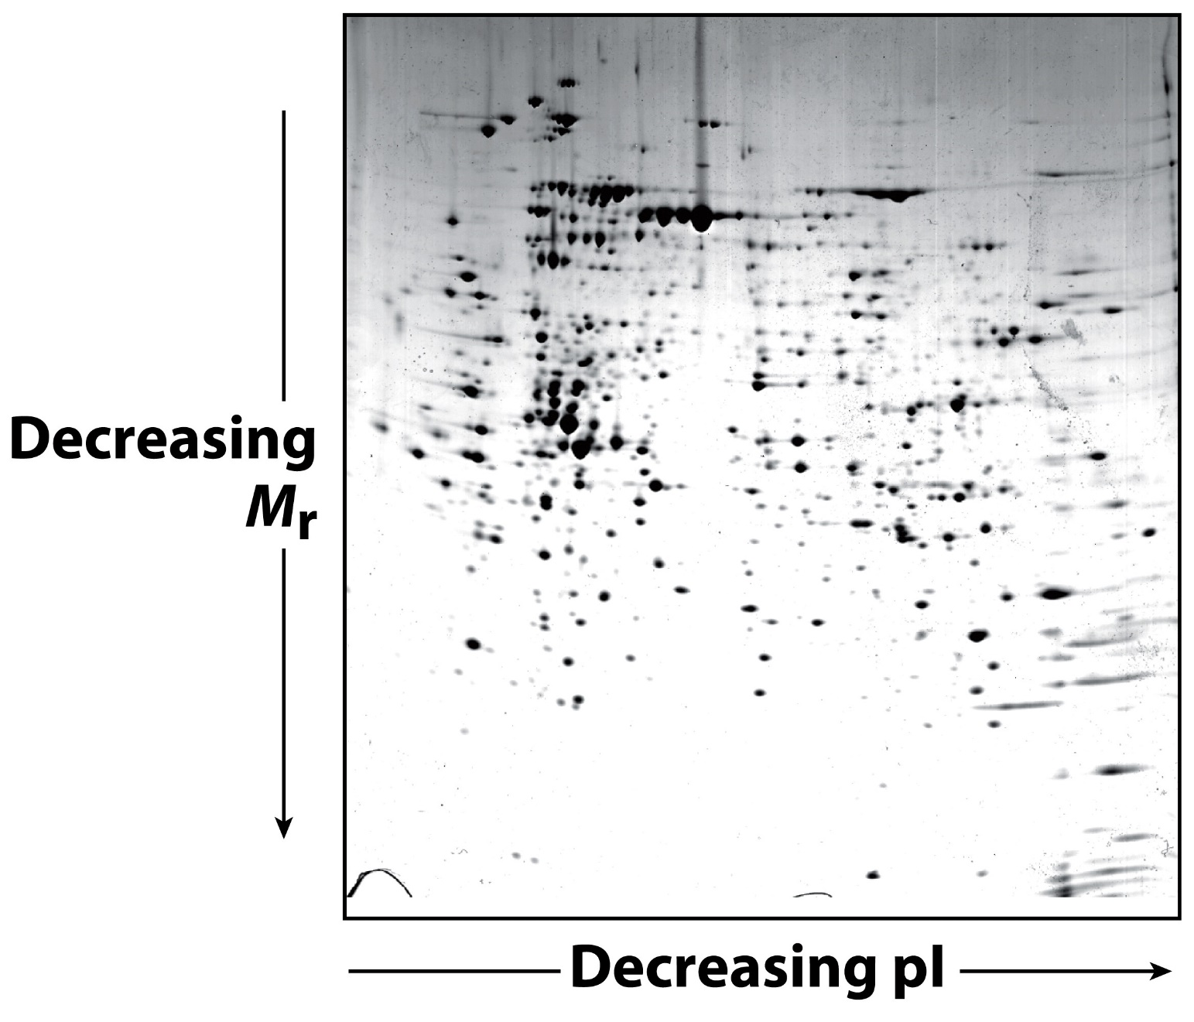
2D Gel Electrophoresis

Slide 25
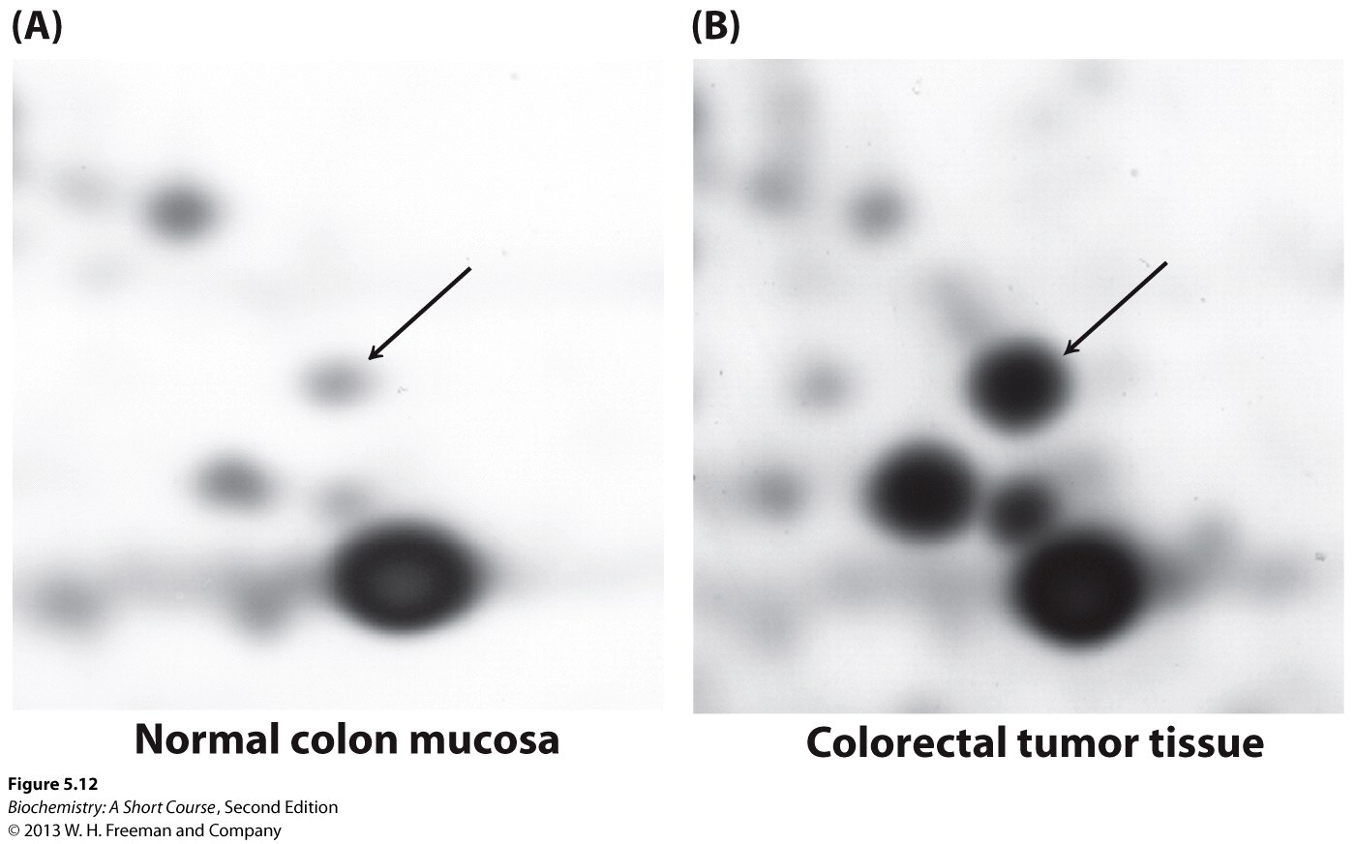
Differences in the “proteome”

